Slide 1
BINARY TREES
Purpose: In this lecture series we will learn about Binary Trees.
Binary Trees are another type of Data Structure that may be implemented using Java’s TreeSet or TreeMap.
Most Binary Tree operations carry an efficient Logarithmic run time behavior.

Slide 2
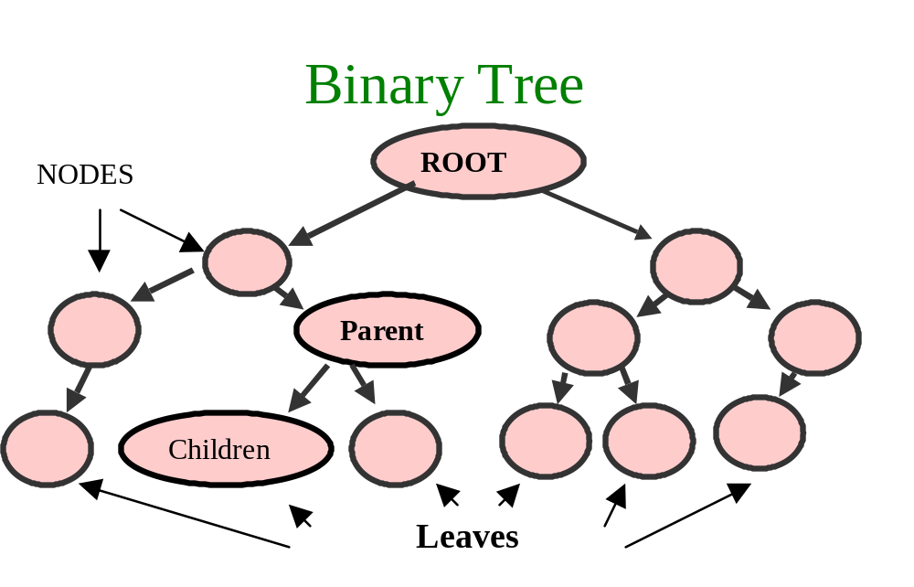
Binary Trees
Chapter 22
Left Subtree
Right Subtree

Slide 3
Resources:
Java Methods AB Data Structures Chapter 5 p.115
Java Essentials Study Guide Chapter 17 p.314 to 330 &
Chapter 20 p.387-398
Barrons Chapter 10 p.328 & Chapter 11 p.378-384
AP Java Text Chapter 19 and Chapter 20 p.883-889

Slide 4
Handouts:
1.Java Classes And Interfaces:
TreeSet
TreeMap
2. TreeNode Class
3. Sample Code (TreeSetAndMap.java & Portions of BSTClass.java)
4. HSA Package (used to Illustrate Tree behaviors)

Slide 5
5. Posted Code Examples:
CreateTree.java
OutPutTrees.java
TreeInsert.java
SearchTree.java
TreeDelete.java
6. Starter code for writing your BST Class
BSTClass SPVM Part.java
7. JESG Comparator p.327-330 & p.397-398

Slide 6
Intro:
What we Will Cover in This Lecture:
Another Look at Collections
Binary Tree Described
Binary Search Tree Defined
List of a Trees required Behaviors
TreeNode Class
Calculation of a Trees Depth
Calculation of a Trees Width

Slide 7
Creating our Own Binary Tree (completed in a Lab)
Tree Traversal (InOrder, PreOrder and PostOrder)
Insert into a Tree
Search for an Object in a Tree
Remove an Object from a Tree (3 situations)

Slide 8
TreeSet Class
TreeMap Class
Big-O of a Binary Tree
Review Various Barrons Examples
The AP AB Requirements

Slide 9
The Collections Interface
Lets focus on the Collection Hierarchy and then, LATER, we will look at the TreeMap and TreeSet Java Classes

Slide 10
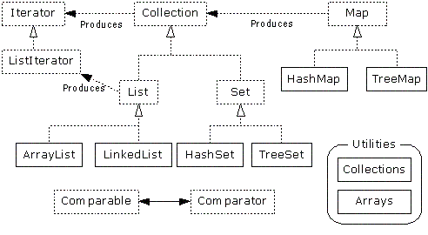

Slide 11
Please note that TreeSet. LinkedList, HashSet and ArrayList all have ISA Collection relationship
As a result, we can perform the following data manipulation:

Slide 12
Set s = new HashSet();
// add elements to the Set
// remember that a TreeSet is a Collection !!!
Set t = new TreeSet(s);
Notice how the initial reference is a Set (interface)
This allows for dynamic associations of this reference with any object that implements Set

Slide 13
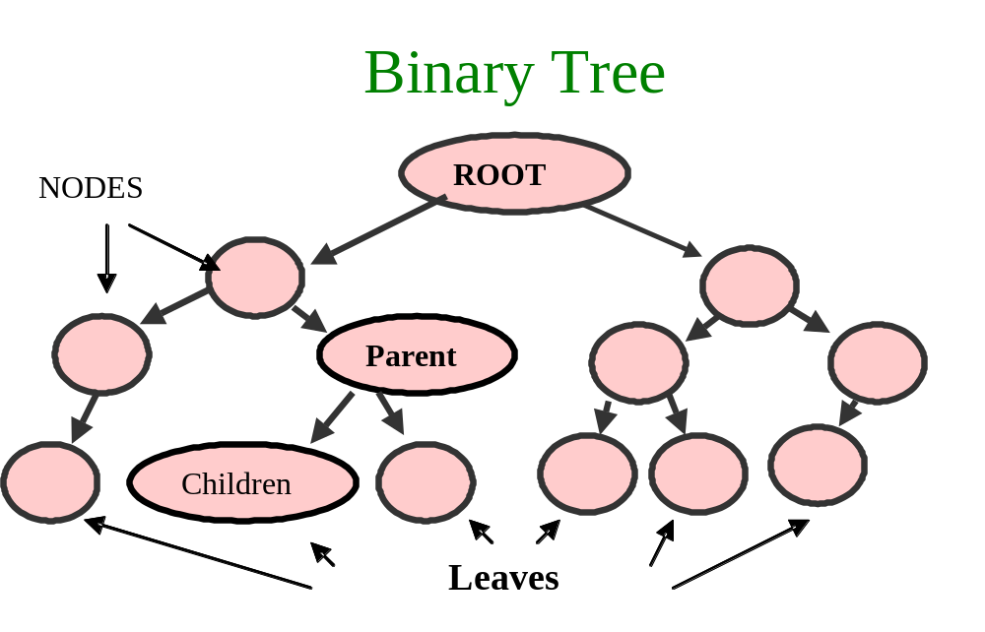

Slide 14
Binary Trees
General Info
TREE:
  Branching Structure
  Each Element Except the TOP one has a link to exactly 1 element higher -- called its PARENT
  elements of a TREE are called its NODES
  top NODE is called the ROOT of the tree

Slide 15
TREE:
  Any Tree NODE can be connected to 1 or more NODES lower in the hierarchy and are called the CHILDREN
  NODES that have no children are called LEAVES
  Intermediate NODES in this path are referred to as the nodes ANCESTORS
  Trees may not have circular paths as NO child can REFER back to Their/Any parent

Slide 16
All NODES in a tree can be arranged in layers with:
  The root at LEVEL 0
  Its children at LEVEL 1
  Their children at LEVEL 2...

Slide 17
The LEVEL of a NODE is equal to the length of the path from the root to that NODE
The total number of LEVELS is called the HEIGHT or the DEPTH of the tree
For Example...

Slide 18
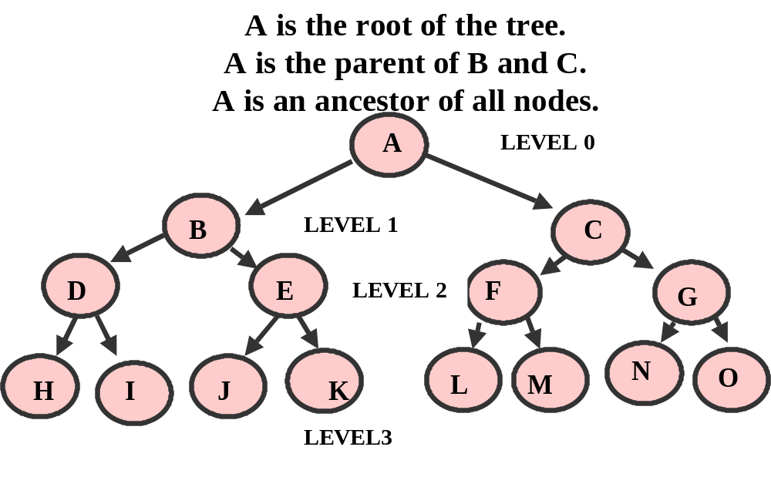

Slide 19
The Preceding Tree was NOT a Binary Search Tree (BST) --- BST is discused later
The ROOT, A, is at LEVEL 0
Its Children, B & C, are at LEVEL 1
Their Children, D E F G, are at LEVEL 2

Slide 20
Height of binary tree :
Number of nodes in the longest path from the root to a leaf of the tree ( or 1 more than the depth or level of the Tree)
The height of the empty tree is 0
The height of a single node tree is 1 (Level 0)

Slide 21
Height of the previous
binary tree ?
A
B
C
D
E
F
G
N
O
H
I
J
K
L
M
Height = 4

Slide 22
Trees can arrange a large number of elements in a relatively SHALLOW tree.
A tree with h levels contains (2 to the h) –1 nodes
A tree with 20 levels contains over 1 million nodes

Slide 23

What is the maximum number of nodes in a binary tree of level 3 (Height 4)?

Slide 24
Complete Binary Tree of Level 3
Number Nodes = (2 ^ 4) – 1
Number Nodes = 15

Slide 25

Complete Binary Tree of Level 3
Each node of level 3 is a leaf and each node less of level 3 has non-empty left and right subtrees.

Slide 26
Binary Trees
General Info
The previous illustration contains 15 nodes in 4 levels or a tree height of 4
(2 ^ 4) - 1 OR 15

Slide 27

What is the maximum number of nodes in a binary tree of level L ?

Slide 28
Complete Binary Tree of Level L
Maximum number of nodes = (2^{L+1} ) - 1

Slide 29
A Complete Binary Tree exists when a tree is Full or when, at the last level, there is NO right child without a left child
The following is another example of a Complete Tree…

Slide 30
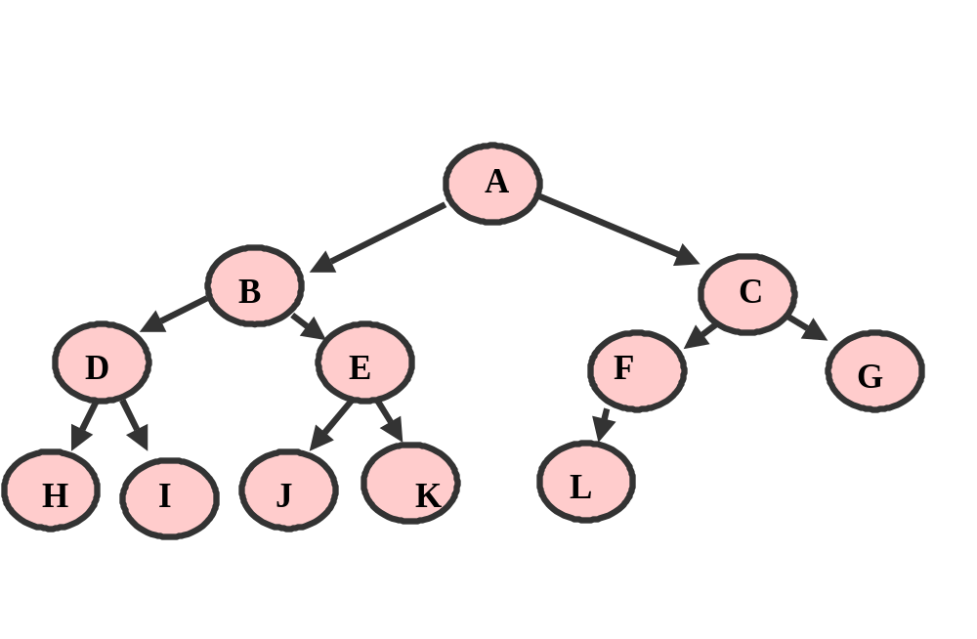

Slide 31
As a result of its shallow nature, trees can be quickly searched & data can be retrieved
Instead of traversing an entire linked list and examining ALL the elements, we can traverse the tree and examine only a few nodes

Slide 32
Binary Trees
Linked List Connection
A list can be viewed as a special case of a tree where:
  the FIRST node is the ROOT
  And the last node is the only leaf
  AND all other nodes have exactly one parent and one child
  A list has only one node at each level
  Each node holds the list of pointers to its children

Slide 33
Binary Trees
Linked List Connection
ROOT

Slide 34
A tree is inherently RECURSIVE in nature as each node in a tree can itself be viewed as the root of a smaller tree

Slide 35
With TREES:
    Knowing just the root we can find all the elements of the tree.
    Given any node, we can find all the nodes in its subtree.
    Recursive branching structure of trees suggests the use of recursive procedures for dealing with them

Slide 36
With TREES:
  BINARY TREE – a tree in which each node has no more than TWO CHILDREN
  Children are called the LEFT CHILD and the RIGHT CHILD
ROOT
LCHILD
RCHILD

Slide 37
Binary Trees
BINARY SEARCH TREES (BST)
  A BINARY SEARCH TREE (BST) is a structure for holding a set of ordered data elements in such a way that it is easy to find any specified element and easy to insert and delete elements

Slide 38
  With Sorted Arrays:
    The array of elements “Divide and Conquer” binary search algorithm allows us to quickly find any array element
    We take the middle element of the array, compare it with the target value and If not equal continue searching the LEFT or RIGHT half of the array depending on the comparison result

Slide 39
    Array weaknesses are with inserting or deleting array elements (in order)

Slide 40
  With Linked Lists:
    A Linked List structure allows us to easily insert and delete nodes but the traversal must go node by node

Slide 41
  With BST:
    BST’s combine the best of arrays and linked lists to allow for quick:
    Search
    insertion
    removal

Slide 42
  BST Principles:
    Each node has no more than 2 children
    Children are called the LEFT and RIGHT subtrees
    The nodes contain data elements FOR WHICH A RELATION OF ORDER IS DEFINED

Slide 43
    For any 2 elements we can say whether the first one is GREATER, EQUAL , or SMALLER than the second
50
25
75

Slide 44
    The elements may be any Object that implements the Comparable interface
    Some BST’s allow NO DUPLICATES ( TreeSet )

Slide 45
  BST has the Following Property:
    For ANY Node its Value is GREATER than any element in that nodes LEFT subtree
    AND
    its Value is LESS THAN than any element in that nodes RIGHT subtree

Slide 46
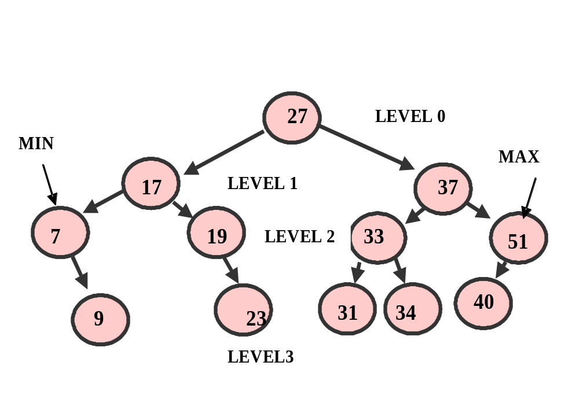

Slide 47
  In a BST it is easy to find the SMALLEST and the LARGEST element:
  To get to the SMALLEST ELEMENT:

Slide 48
  Start at the ROOT
  Go LEFT as long as possible, gets us to the NODE containing The SMALLEST element

Slide 49
  To get to the LARGEST ELEMENT:
  Start at the ROOT
  Go RIGHT as long as possible, gets us to the NODE containing The LARGEST element

Slide 51
  A Balanced Tree exists when there are about the same number of nodes in all of the left and right subtrees
  Our previous example could be considered a balanced tree

Slide 52
  Maintaining a balanced Tree is critical if we are to maintain the logarithmic efficiency of most of the behaviors of a Binary Tree
  Why ?

Slide 53
  Because a Tree can degrade to linear efficiency if all nodes are on one side
  For Example, if the first node added in the tree has a value of 51, every other node inserted will be on the left side (we will see how this happens shortly)

Slide 54
  A Full Binary Tree exists when every leaf node is on the same level and every non-leaf node has 2 children

Slide 55
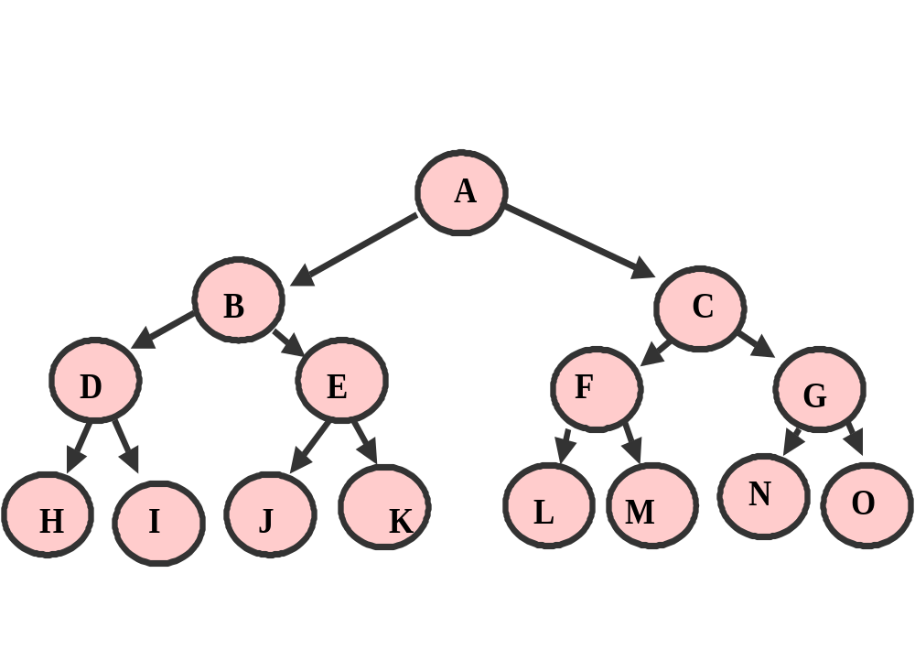

Slide 56
In order to implement a Binary Tree, you need to provide for the following behaviors:
Traverse a Tree (Inorder, PreOrder and PostOrder)
Insert a node
Search for a specific element in the tree
Remove an element from the tree

Slide 57
We will eventually create our own BST Class that performs all of these behaviors
However, we first need to look at aa AP class that will be used as our “NODE”
TreeNode.java

Slide 58
Unlike a Linked List, there is no Binary Tree Class in Java
We will need to create our own Tree Class or utilize the TreeSet or TreeMap Java classes

Slide 59
Much like the Linked List, the College Board provides a node class called TreeNode that can be used to serve as the NODE for each element in a tree

Slide 60
The TreeNode class has class level attributes to maintain an Object (Value) as well as references to any Left or Right children
public class TreeNode
{
private Object value; // Comparable
private TreeNode left;
private TreeNode right;

Slide 61
The Object in the TreeNode needs to implement the Comparable interface and code for the equals method (Integer and String class)
The constructor establishes the state of a node
public TreeNode (Object initValue, TreeNode initLeft,
TreeNode initRight)

Slide 62
The TreeNode is mutable and also provides appropriate accessor methods
Lets look at the TreeNode class in your handout (it is also posted on the class website)

Slide 63
The TreeNode can be used in a BST Class to maintain the state of the ROOT of the tree
You access nodes in the tree FROM the root node

Slide 64
In the following WROTE example, we can build a Binary tree (AP Java p.812-814):

Slide 65
TreeNode root, n1, n2, n3, n4, n5, n6;
n1 = new TreeNode ("X", null, null);
n2 = new TreeNode ("Y", null, null);
n3 = new TreeNode ("H", n1, n2);
n1 = new TreeNode ("T", null, null);
n2 = new TreeNode ("U", null, null);
n4 = new TreeNode ("J", n1, n2);
n1 = new TreeNode ("V", null, null);
n5 = new TreeNode ("K", n1, null);
n6 = new TreeNode ("C", n4, n5);
root = new TreeNode ("A", n3, n6);

Slide 66
TPS: Draw the Resulting Tree
Determine the number of Levels & Min & Max Nodes

Slide 67
A (root)
H (n3) C(n6)
X Y J(n4) K(n5)
T U(n2) V(n1)

Slide 68
Calculation of a Trees Depth
The Depth of a NODE in a Tree is the length of the path from the root of the tree to that node
In the previous Illustration:

Slide 69
node T has a Depth of 3
node H has a depth of 1
node A (root) has a depth of 0

Slide 70
So, a nodes depth is equal to its level
To determine the DEPTH of a TREE we determine the level/depth of its DEEPEST leaf
The depth of the tree in our example is 3

Slide 71
Call the following method (AP Java p.815-816):
Go to “Calculation of a Trees Depth” in your handout
Review the Code
RUN CreateTree.java for class

Slide 72
Calculation of a Trees Width
A Trees Width is the largest number of nodes found at a given depth

Slide 73
At depth 0, the width of the tree is 1
In the previous Illustration:
The trees width at node U (level 3) is 3
The trees width at node Y (level 2) is 4
Call the following method (AP Java p.816-818):

Slide 74
Go to “Calculation of a Trees Width” in your handout
Review the Code
RE-RUN CreateTree.java for class

Slide 75
TPS: Write code to produce the Maximum width of a Tree

Slide 76
Creating our Own Binary Tree Class (completed in a Lab)
You will need to create a BST class that supports all of the required behaviors (create, insert, find, remove, traverse)

Slide 77
public class BST
{
private TreeNode root;
Your class needs to support the following in SPVM:
// Create a Binary Search tree of names
BST myTree = new BST("Ellis");

Slide 78
TPS: Write the supporting BST class constructor

Slide 79
Traversing a BST
InOrder, PreOrder and PostOrder
With BST’s it is much easier to implement traversals recursively than iteratively
TREE TRAVERSAL --- “visiting” each node in a BST
Each node is processed once

Slide 80
Binary Trees
BINARY SEARCH TREES (BST)
When a BST is traversed in order the values in the nodes will be in order
50
25
75

Slide 81
Assume a Binary Search Tree of Integers inserted in the following order:
15 8 25 6 14 24 20 22 30 13 26

Slide 82
The shape of the BST depends on the order in which the elements are inserted.
If we start with the largest or smallest element it will be placed in the ROOT and one entire subtree will remain empty !!!

Slide 83
Binary Trees
(BST) Traversal
3 Methods of Traversal:
  PREORDER
  POSTORDER
  INORDER

Slide 84
Inorder
Display Left subtree first, then the parent and finally the right subtree

Slide 85
Inorder Traversal ?
15
8
25
6
24
14
30
26
13
20
22

Slide 86
Inorder Traversal :
15
8
25
24
6
14
30
20
26
13
22
6 8 13 14 15 20 22 24 25 26 30

Slide 87
The Inorder Traversal is:
6 8 13 14 15 20 22 24 25 26 30
TPS: Write out recursive code for this traversal

Slide 88
// Traverses tree nodes IN ORDER
private void inOrder(TreeNode t)
{
if (t != null)
{
inOrder(t.getLeft());
nodeList = nodeList + " ---> " + (t.getValue()).toString();
inOrder (t.getRight());
}
}

Slide 89
3 Methods of Traversal:
  PREORDER
  POSTORDER
  INORDER

Slide 90
Preorder Display the parent first, then the left subtree and finally the right subtree

Slide 91
Preorder Traversal ?
15
8
25
6
24
14
30
26
13
20
22

Slide 92
Preorder Traversal :
15
8
25
6
24
14
30
26
13
20
22
15 8 6 14 13 25 24 20 22 30 26

Slide 93
The Preorder Traversal will be displayed as:
15 8 6 14 13 25 24 20 22 30 26
TPS: Write out recursive code for this traversal

Slide 94
// Traverses tree nodes PRE ORDER
private void preOrder(TreeNode t)
{
if (t != null)
{
nodeList = nodeList + " ---> " + (t.getValue()).toString();
preOrder(t.getLeft());
preOrder (t.getRight());
}
}

Slide 95
Binary Trees
(BST) Traversal
3 Methods of Traversal:
  PREORDER
  POSTORDER
  INORDER

Slide 96
Postorder Display the left subtree first, then the right subtree and finally the parent

Slide 97
Postorder Traversal ?
15
8
25
6
24
14
30
26
13
20
22

Slide 98
Postorder Traversal :
15
8
25
6
24
14
30
26
13
20
22
6 13 14 8 22 20 24 26 30 25 15

Slide 99
The Postorder Traversal will be displayed as:
6 13 14 8 22 20 24 26 30 25 15
TPS: Write out recursive code for this traversal

Slide 100
// Traverses tree nodes POST ORDER
private void postOrder(TreeNode t)
{
if (t != null)
{
postOrder(t.getLeft());
postOrder (t.getRight());
nodeList = nodeList + " ---> " + (t.getValue()).toString();
}
}

Slide 101
  TRAVERSAL (inorder, preorder, postorder)
  INSERT (a NODE)
  FIND (a NODE)
  DESTROY (THE BST)
  REMOVE (a NODE)

Slide 102
Insert into a Tree
The shape of the BST depends on the order in which the elements are inserted. If we start with the largest or smallest element it will be placed in the ROOT and one entire subtree will remain empty !!!

Slide 103
When adding a node to the BST we need to maintain the order where the “value” part of the parent node is GREATER then all children in the left subtrees but LESS then all children in its right subtree

Slide 104
We will navigate the tree to find the appropriate empty subtree
We will insert our new node there and set its children to null
We will leverage this property to effectively search the tree with logarithmic efficiency

Slide 105
Here is the search algorithm:
create a new node (TreeNode) containing the new value to be added with empty subtrees
if the root is null
set the root to this node
otherwise

Slide 106
as long as we have node in the tree to traverse
if the node value we are searching for matches the current node
return false if our BST does not allow duplicates
otherwise if the value we are searching is less than the current node
continue the search from the left subtree
else
continue the search from the right subtree

Slide 107
once the end of a particular subtree has been reached (no more nodes to search)
we insert the new node into the appropriate child node

Slide 108
An Example

Slide 109
Insert :
15 8 25 6 14 24 20 22 30 13 26
15

Slide 110
Insert :
14 8 25 6 14 24 20 22 30 13 26
15
8

Slide 111
Insert :
14 8 25 6 14 24 20 22 30 13 26
15
8
25

Slide 112
Insert :
15 8 25 6 14 24 20 22 30 13 26
15
8
25
6

Slide 113
Insert :
15 8 25 6 14 24 20 22 30 13 26
15
8
25
6
14

Slide 114
Insert :
15 8 25 6 14 24 20 22 30 13 26
15
8
25
6
14
24

Slide 115
Insert :
15 8 25 6 14 24 20 22 30 13 26
15
8
25
6
14
24
20

Slide 116
Insert :
15 8 25 6 14 24 20 22 30 13 26
15
8
25
6
14
24
20
22

Slide 117
Insert :
15 8 25 6 14 24 20 22 30 13 26
15
8
25
6
14
24
30
20
22

Slide 118
Insert :
15 8 25 6 14 24 20 22 30 13 26
15
8
25
6
24
14
30
20
13
22

Slide 119
Insert :
15 8 25 6 14 24 20 22 30 13 26
15
8
25
6
24
14
30
26
13
20
22

Slide 120
Our tree:
15 8 25 6 14 24 20 22 30 13 26
15
8
25
6
24
14
30
26
13
20
22

Slide 121
Our Tree:
15
8
25
6
24
14
30
26
13
20
22
What is the height if the tree?

Slide 122
Height :
15
8
25
6
24
14
30
26
13
20
22
Height = 5

Slide 123
Run TreeInsert.java for Illustration

Slide 124
TPS: How are we going to actually “Insert” the new node ?
Given the following simple example:
C
A D
If we were to add a node containing the value F
Where would the new node go ?

Slide 125
C
A D
F
It would become the RIGHT child of D
How does this actually happen in code ?

Slide 126
Review the Code that performs an iterative Insert in the “Insert into a Tree” section of your handout

Slide 127
Binary Trees
(BST) Case Study
We will be discussing and providing an example, by way of the case study, the following BST functions:
  TRAVERSAL (inorder, preorder, postorder)
  INSERT (a NODE)
  FIND (a NODE)
  REMOVE (a NODE)

Slide 128
Search for an Object in a Tree
We need to be able to retrieve a specific node from a BST
When we inserted nodes into the BST we maintained the order property

Slide 129
We will leverage this property to effectively search the tree with logarithmic efficiency
Here is the search algorithm:

Slide 130
if the node = null
return NO MATCH
otherwise
if the search data equals the value part of the node
return MATCH
otherwise if the search data is less than the value part of the node
search the left subtree
otherwise
search the right subtree

Slide 131
The BST where Integers
15 8 25 6 14 24 20 22 30 13 26
Are inserted in this order, walk thru searches for different Integers
Run searchTree.java for Illustration

Slide 132
Our tree:
15 8 25 6 14 24 20 22 30 13 26
15
8
25
6
24
14
30
26
13
20
22

Slide 133
Run searchTree.java for Illustration

Slide 134
Lets look at the code in your handout under the “Search for an Object in a Tree” section for a recursive Search solution

Slide 135
TPS: Write an Iterative Search Routine

Slide 136
You can implement the search recursively or iteratively, however if asked to write such code on an AP exam, write an iterative solution as it is easier to “desk check” and less prone to serious error

Slide 137
Binary Trees
(BST) Case Study
We will be discussing and providing an example, by way of the case study, the following BST functions:
  TRAVERSAL (inorder, preorder, postorder)
  INSERT (a NODE)
  FIND (a NODE)
  REMOVE (a NODE)

Slide 138
Binary Trees
(BST) Remove
Removing a node requires rearranging the remaining nodes in a tree
1st --- find the node to be removed , then determine which condition applies:

Slide 139
Binary Trees
(BST) Remove
node has 1 or no children:
  we can rearrange the references to bypass the node by appending its only child directly to the removed node’s parents
  Example:

Slide 140
Deleting a node from a binary tree
L
D
P
C
H
A
F
J

Slide 141
To delete a leaf...
L
D
P
C
H
A
F
J

Slide 142
To delete a leaf...
L
D
P
C
H
Set appropriate parents Right Child toNULL
A
F
J

Slide 143
To delete a leaf...
L
D
P
C
H
A
F

Slide 144
NOTE: As with the insertion of a node, we need to keep track of a child’s parent node in order to unlink the removed node from the tree
First, search for the node to be removed by calling your find method
You will need to enhance the find method to maintain the reference to the PARENT of the node to be removed

Slide 145
If the node to be removed has no children, simply set the appropriate child’s node to null

Slide 146
// Node has no children, set appropriate Parent child node to null
if (toRemove.getLeft() == null && toRemove.getRight() == null)
{
if (toRemoveParent.getLeft() == toRemove)
{
toRemoveParent.setLeft(null);
}
else
{
toRemoveParent.setRight(null);
}
return true;
}

Slide 147
Run BSTClass.java for Illustration of leaf node removal

Slide 148
Deleting a node with one child...
L
D
P
C
H
A
F
J

Slide 149
Deleting a node with one child...
L
D
P
C
H
Make Reference of parent skip over the deleted node and point to the child of the node we want to delete
A
F
J

Slide 150
Deleting a node with one child...
L
D
P
H
A
F
J

Slide 151
If the node to be removed has one child, set the node to be removed’s PARENT left or right child to the only child of the node to be removed

Slide 152
// Node has one child, set removed nodes parent to its only child
if (toRemove.getLeft() == null || toRemove.getRight() == null)
{
TreeNode tt;
// determine where the node to remove's child is
if (toRemove.getLeft() == null)
tt = toRemove.getRight();
else
tt = toRemove.getLeft();
if (toRemoveParent.getLeft() == toRemove)
{
toRemoveParent.setLeft(tt);
}
else
{
toRemoveParent.setRight(tt);
}
return true;
}

Slide 153
Run BSTClass.java for Illustration of node with 1 child removal

Slide 154
Deleting a node with 2 children...
L
D
P
C
H
N
R
A
J

Slide 155
Deleting a node with 2 children...
L
node’s replacement will be the GREATEST element of its LEFT subtree
D
P
C
H
N
R
A
J

Slide 156
Deleting a node with 2 children...
J
BST Order Still Holds as new node, coming from LEFT subtree is SMALLER than Any
Node in RIGHT subtree
D
P
C
H
N
R
A

Slide 157
  GO LEFT ONCE
  THEN, GO AS FAR RIGHT AS POSSIBLE FOR THE NODE’S REPLACEMENT
  MAKE THAT NODE THE PARENT (TO REPLACE THE DELETED NODE)

Slide 158
Lets review the removal code in your handout in the “Remove an Object from a Tree Section”

Slide 159
Run BSTClass.java for Illustration of node with 2 children removal

Slide 160
Lets run thru the additional examples in the “Remove BST” section of your handout

Slide 161
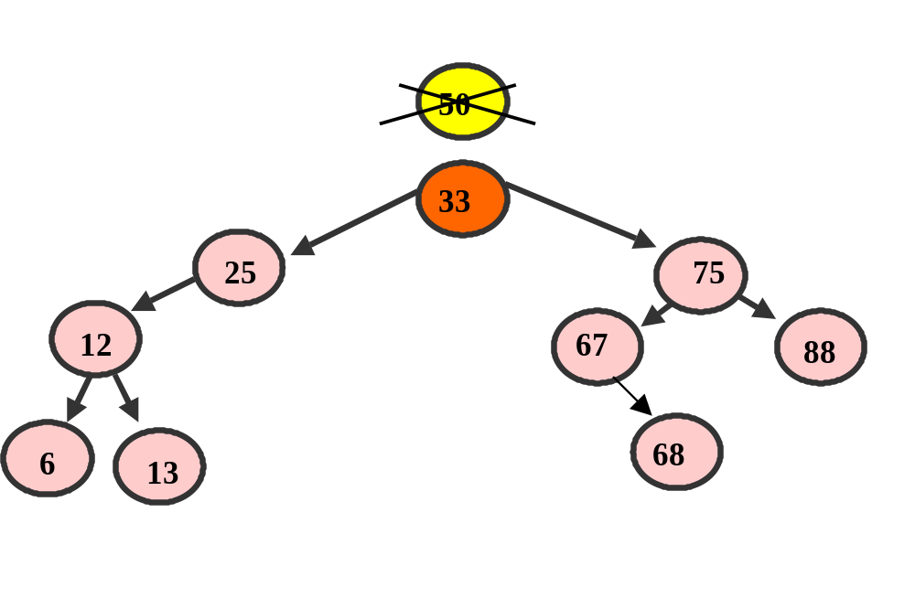
Binary Trees
(BST) Remove

Slide 162
Lets run thru the DRIVER that utilizes a completed BST Class following the “Remove BST” section of your handout

Slide 163
TreeSet Class
A TreeSet holds OBJECTS
TreeSets implement a Balanced Tree ( provides O(log(n)) performance )
Assumes that Objects (values) being stored maintain some order and this class arranges them according to such an order (BST)

Slide 164
As with the HashSet NO DUPLICATE OBJECTS (Values) ARE ALLOWED
For an object to be contained in a TreeSet it MUST implement the Comparable Interface so that ordering can occur
String, Integer or Double classes are valid as well as any other Object that implements comparable

Slide 165
Walk thru TreeSetAndMap.java located in the “TreeSet” section of your handout

Slide 166
Because a TreeSet is balanced, insertions and removals are guaranteed to be logarithmic O(log n)
The HashSet provides better time, O(1) or constant time, however, if we require order in our set, then a TreeSet is a better selection

Slide 167
Also, the hash performance is dependant on the quality of the hash function so a poorly designed hash function can result in collisions degrading performance to linear O(n)
TreeSets Iterate in an order that compliments a BST while HashSets iterate in random order

Slide 168
TreeMap Class
A TreeMap holds PAIRS of Objects, a KEY and a VALUE
Implements a map as a BST ORDERED BY KEYS
When Initializing an empty TreeMap you can only use KEYS that are Comparable (an object that implements the comparable operator)

Slide 169
With the TreeSet the values are compared against each other
With the TreeMap there is no ordering of the values, but the BST is ordered according to the KEYS

Slide 170
Walk thru TreeSetAndMap.java located in the “TreeMap” section of your handout

Slide 171
TPS: Reverse the Key value Pairs by using String as the key and Integer as the value ) JESG p.327

Slide 172
Big-O of a Binary Tree
Insertion into a balanced tree is O(log n)
If the tree is severely unbalanced the efficiency is reduced to linear O(n)
Search/find method of a balanced tree is O(log n)

Slide 173
Big-O of a Binary Tree
If the tree is severely unbalanced the efficiency is reduced to linear O(n)
All tree traversals are linear O(n)
TreeSet insertion & Removal is O(log n)

Slide 174
Review Various Barrons Examples
Summing values in a Tree Example 1 p.338
Checking to see if 2 trees are similar Example 2 p.338
Duplicate a Tree Example 3 p.339
Height of a Tree Example 4 p.339

Slide 175
AP AB Subset Requirements
Students are expected to:
Understand the properties of a Binary Tree and a Binary Search Tree (know what differentiates them)
Use (work with) the TreeNode class

Slide 176
Traverse a Binary tree Inorder, Preorder and Postorder
Insert a node
Search for an element
Remove a node (all 3 situations)

Slide 177
Calculate depth, width, max width of a tree
Determine (thru code) if a tree is balanced or complete
Implement the TreeSet and TreeMap

Slide 178
LABS: Create a BSTClass
POE Revisited
MBS Using a Binary Tree (can implement with your class, treeSet or TreeMap)
Various Exercises (Handout)
Multiple Choice from Barrons: Chapter 10 p.348 Questions # 1 to 8 &
12 to 23
Chapter 11 p.388 # 1 to 4, 7, 8, 10 to 24

Slide 179
TEST AFTER LABS
MULTIPLE CHOICE & 2 FREE RESPONSE QUESTIONS (3 Days)

